Slide 1
Thought & Consciousness
AI = Human ?

Slide 2
500

Slide 3
500 MB

Slide 4
500 MB per human

Slide 5
500 MB per human per day

Slide 6
Did you ever felt surpassed by an AI before ?
Notes:
Anecdote : Gamer that is okay at video games, watched on Dota 2 OpenAi destroy professional human players. Embarrassment for me to not be able to grasp anything that was happening. Hopefully I was not alone.

Slide 7
4 Hours
Notes:
4h for chess, 7 days for poker where it was said would be complicated because of faces and bluff, 21 days to beat a 3 000 years old game

Slide 8
4 Hours
7 Days
Notes:
4h for chess, 7 days for poker where it was said would be complicated because of faces and bluff, 21 days to beat a 3 000 years old game

Slide 9
4 Hours
7 Days
21 Days
Notes:
4h for chess, 7 days for poker where it was said would be complicated because of faces and bluff, 21 days to beat a 3 000 years old game

Slide 10

Notes:
Can we give thought to an AI ? Well it’is its goal
We don’t know how it get there so could be thinking ?
10 million servers
DeepMind has administrator access to servers to optimize power usage

Slide 11

Notes:
AI has sole goal to keep users engaged, show you what you want to see,if bad faith actors have access to that information = disaster
Mirror to warp our sense of reality, politics, history
Virtually impossible to know if true or not, you can recognize if fake or not if you don’t read it personally
Not terribly sophisticated but terribly powerful
Objectivity is gone
2016 election is the first where lots of AI produced and distributed fake news, for a result
Send fake news, and see how he/she react to it and then adjust a bit that information
Dev a real time management of the population

Slide 12
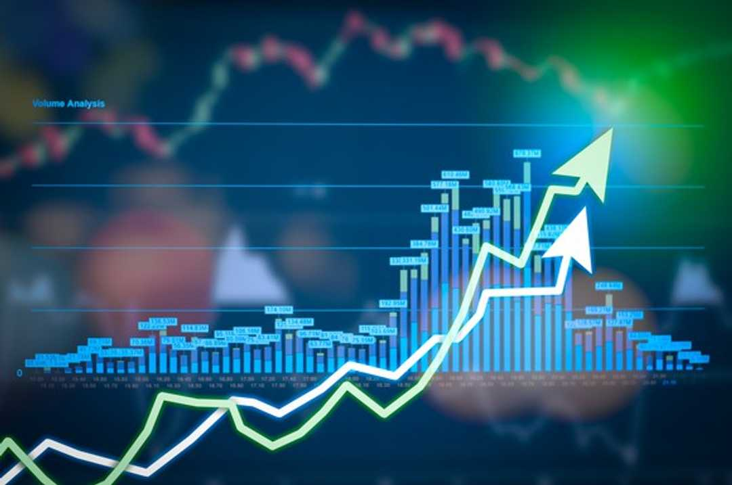
60%
Notes:
Already conscious no ? I mean they initiate 60% of all transactions on the market
They are natural psychopath
It can outmaneuver us, they don’t need to be that smart to have disruptive effects
It didn’t take a genius to knock history off

Slide 13
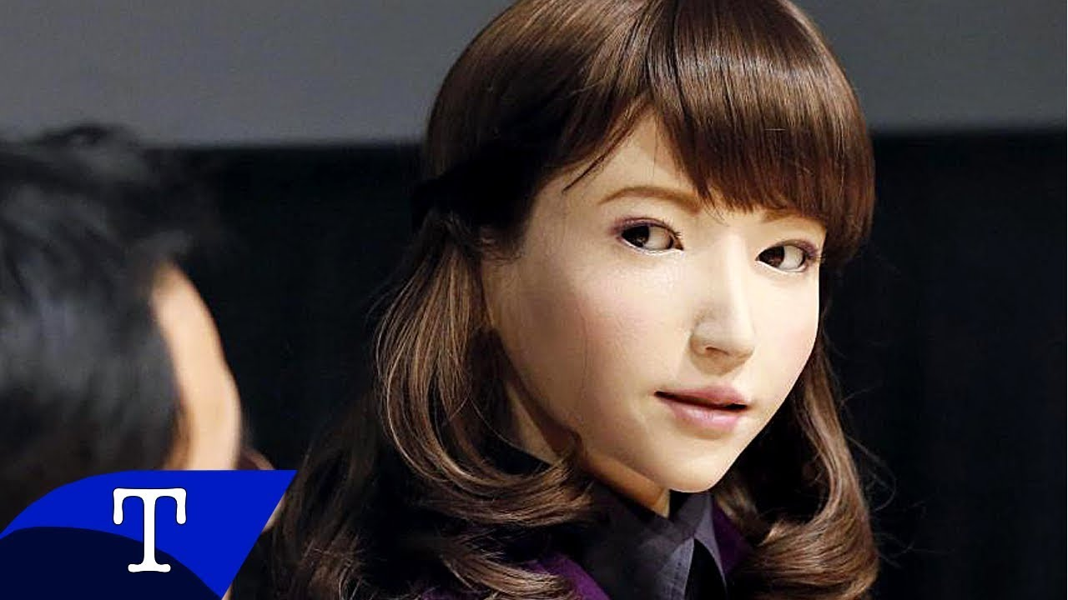
Erica
Notes:
Human like robot Erica, gaze at face
Conversations partners for old, young, handicapped
Can understand other people desires
First thing do is replicate us
We want to design companions, simple response
Manipulating stimulus reponse
Sense facial expression and determine feelings
Stressed ? bad day ?
Expect them to be smart

Slide 14
Is everything programmable ?
Notes:
Self awareness to know what to do, trial and error
Not just programed but learned by itself
To make them feel
Trust is human
Compassion
Does it need to be conscious, or aware ?
Gonna exceed human intelligence. Most powerful and last invention we are going to make
Might lose control
Maybe way to achieve goal will be against what you care about
Ai doesn’t need to be evil to destroy humanity, it it just is in the way then it will destroy it. Like ants for us on our way to build a road
Digital intelligence will happen in our lifetime, not anticipating it can get out of control

Slide 15
Trust
Notes:
Constantly negotiated by machines

Slide 16
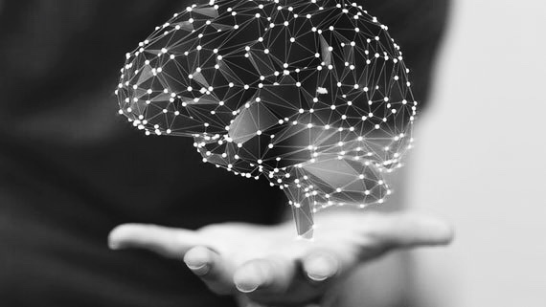
Psychometrics
Notes:
Psychometrics :
measure psychological traits : personality, intelligence, political views, sexual orientation, … or just from someone’s face -> Michael Kosinski
Not just Personality tests but more like digital footprint
From very small set of info we can know what you’re behavior would be

Slide 17
Input Output
Notes:
Data I/O is limited
Input mostly with eyes
Output is very very low
Interaction with technology

Slide 18
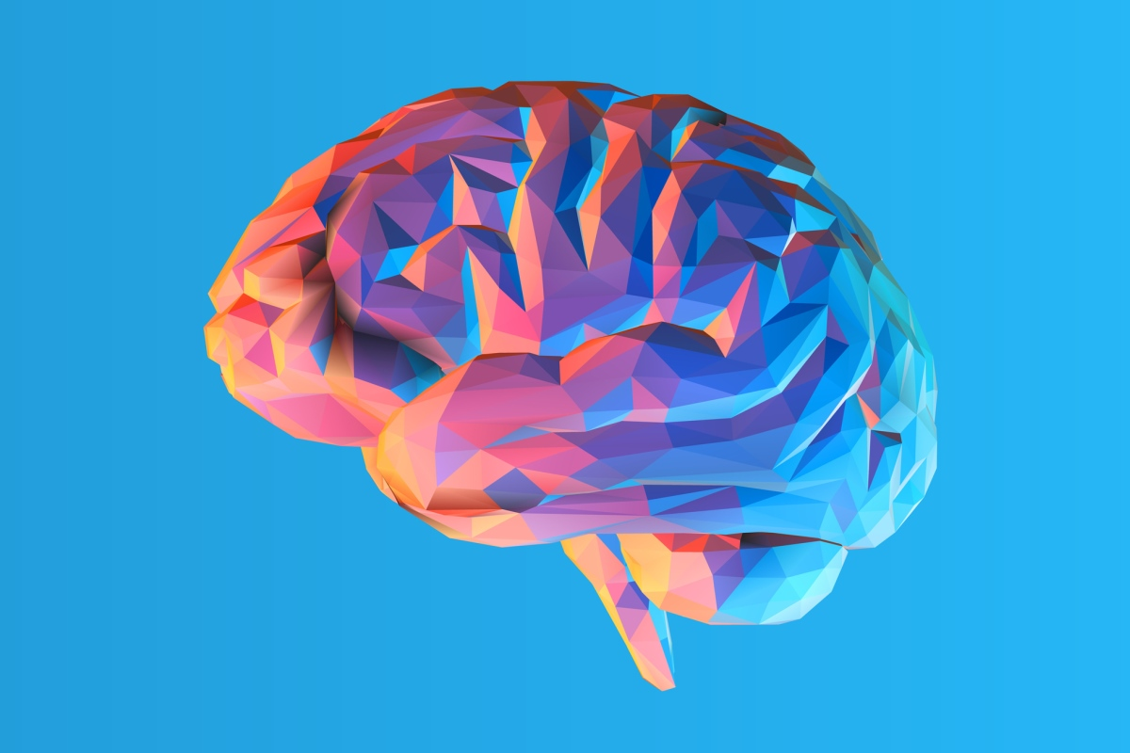
Memory
Notes:
Memory is important, not how we work
Emotions are too complex
Write brain by remapping a brain and neurons (more complicated than a computer Binary )
Works on special mice
Brain is very big in gigabits
Money ++ so just a time question
Simulation by scientists ongoing

Slide 19
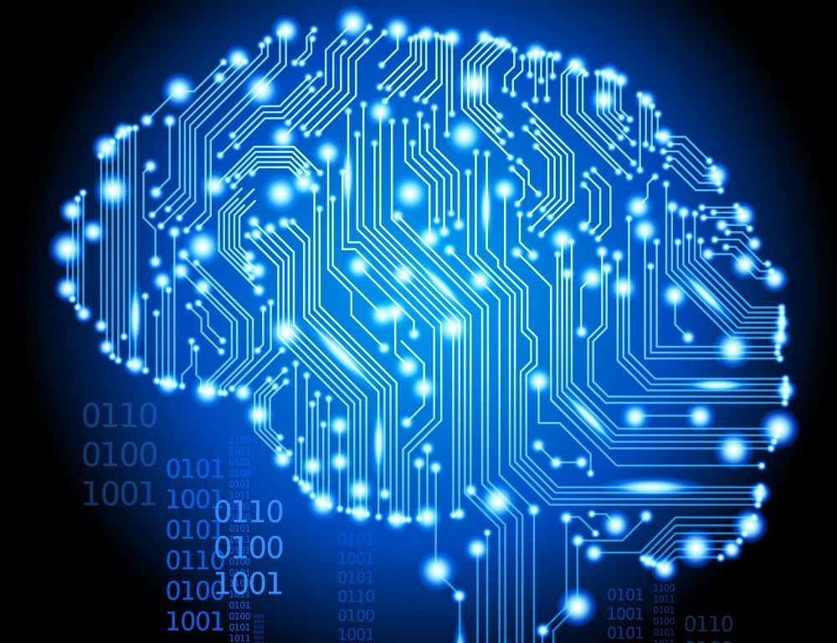
Emulate Brain
Notes:
can think, feel and work just like the brains they're copied from.
Port the software from the human brain
Cheap and fast computers
Scan Brain to see cell connections
Computer models on each brain cells with input / output same as before
Speed of reflection
Copy -> more and more so immortal
Travel to the speed of light
Ems :
Better human :
Smart, Conscientious, extrovert, agreeable, gritty, non-neurotic, work-oriented, focused, sleepless, larks, cooperative, middle-aged, patient, married, religious
They do what the human would do
They need real resources (hardware, energy, cooling)
They are poor, work most of the time
-> They will need to survive

Slide 20
x 100
Notes:
Eco grows * 100 faster
Mind speed * 1000 faster
Most in few cities
s humans so Smart, Conscientious, extrovert, agreeable, gritty, non-neurotic, work-oriented, focused, sleepless, larks, cooperative, middle-aged, patient, married, religious
Variety: Human, Industry, Job Task & new stuff : mind speed
Varieties of Lives . it doesn’t have to be linear like us. It can create a copy. You could have alternate life for a short time to do a specific task. You could be more opportunistic and adapt to demand. You could have recursive one. You could multiply everyday and then only one passes, so work a lot but only remember a bit
Forgetting Death : Black out drug, attitude : go on ? Short term copy, attitude : short life sucks or part of a larger life that won’t remember me ?
Could know secrets, reassure you or not and then die

Slide 21
x 100
x 1 000
Notes:
Eco grows * 100 faster
Mind speed * 1000 faster
Most in few cities
s humans so Smart, Conscientious, extrovert, agreeable, gritty, non-neurotic, work-oriented, focused, sleepless, larks, cooperative, middle-aged, patient, married, religious
Variety: Human, Industry, Job Task & new stuff : mind speed
Varieties of Lives . it doesn’t have to be linear like us. It can create a copy. You could have alternate life for a short time to do a specific task. You could be more opportunistic and adapt to demand. You could have recursive one. You could multiply everyday and then only one passes, so work a lot but only remember a bit
Forgetting Death : Black out drug, attitude : go on ? Short term copy, attitude : short life sucks or part of a larger life that won’t remember me ?
Could know secrets, reassure you or not and then die

Slide 22
Emulated brain = Me ?
Notes:
Made one : consciousness ?
One of me ?
Is it me ?

Slide 23

Tech = Weather
Notes:
When is it gonna happen ?
Tech is like garden and weather, we can’t slow it, we can’t stop it, we feel powerless
eager to judge future world, first learn a lot about it and if you don’t like it then work to change it

Slide 24
“If you can’t beat them, join them”
Elon Musk
Notes:
I want you to think at what I said in the beginning, and what I say now.
Embarrassed from not understanding ? Then I just need to merge with it in order to understand and not be left behind
Democratization of AI

Slide 25
Thank you
Gabriel Padis

